Slide 1

YOKOHAMA RACE HISTORY
Elite Analysis · Past 8 Years · April 2026
USA Triathlon High Performance

Slide 2
Key Course Differentiators
Yokohama
YOKOHAMA
COURSE AT A GLANCE
Set on Yokohama’s waterfront around Yamashita Park, this course is flat, fast, and exposed to coastal weather. The race is usually less about elevation and more about making the right group, staying safe on wet roads, and arriving at T2 ready to run.
Swim:
1.5 km
Bike:
40.0 km (2026)
Run:
10.0 km
Format:
Standard Triathlon
COURSE FEATURES
Bike Laps:
10 (~16 key turns/lap est.)
Run Laps:
4 (Surface likely pavement)
• Sea swim from a pontoon start on the Yokohama waterfront.
QUICK LINKS
• Flat urban multi-lap bike course. Positioning and handling are key with likelihood of rain and wind.
Current Race Info:
2026 World Triathlon race info
• Flat 10 km run where podium decisions usually come down to a large group starting the run together off the bike
Last Year's Results:
2025 Yokohama results
• Rain and wind are recurring variables; 2025 bike result was shortened to 37.2 km.
Race Replay:
2025 results + TriathlonLIVE replays

Slide 3
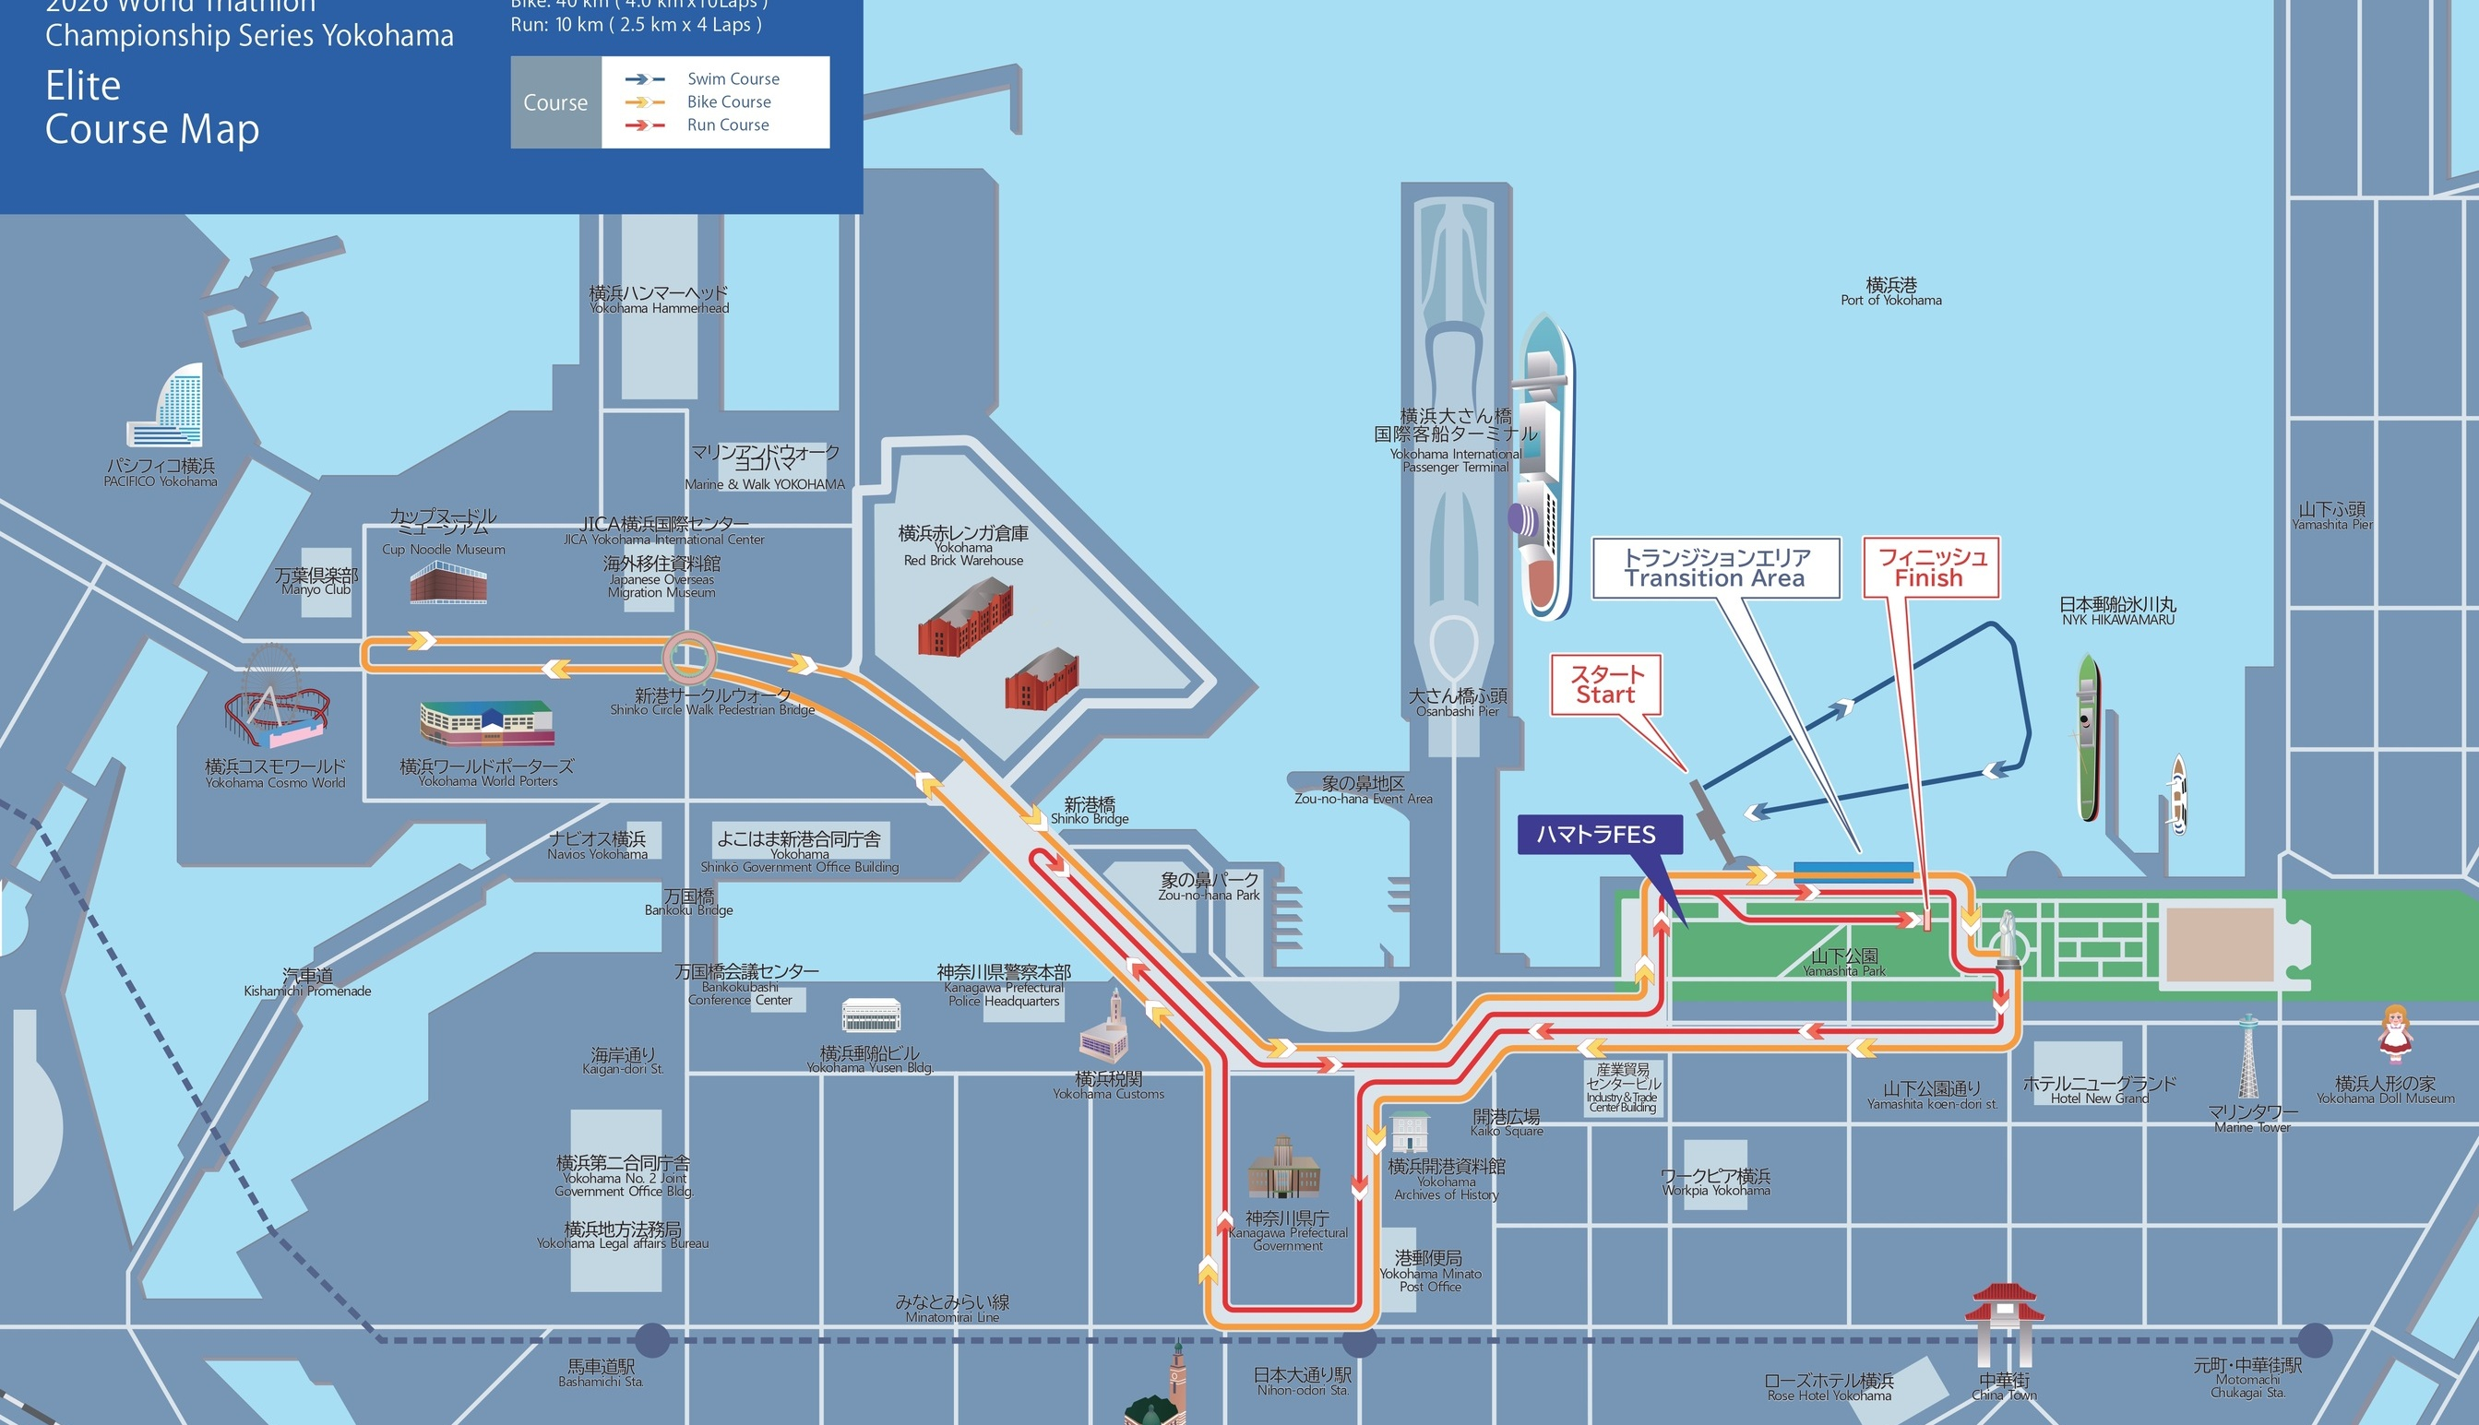
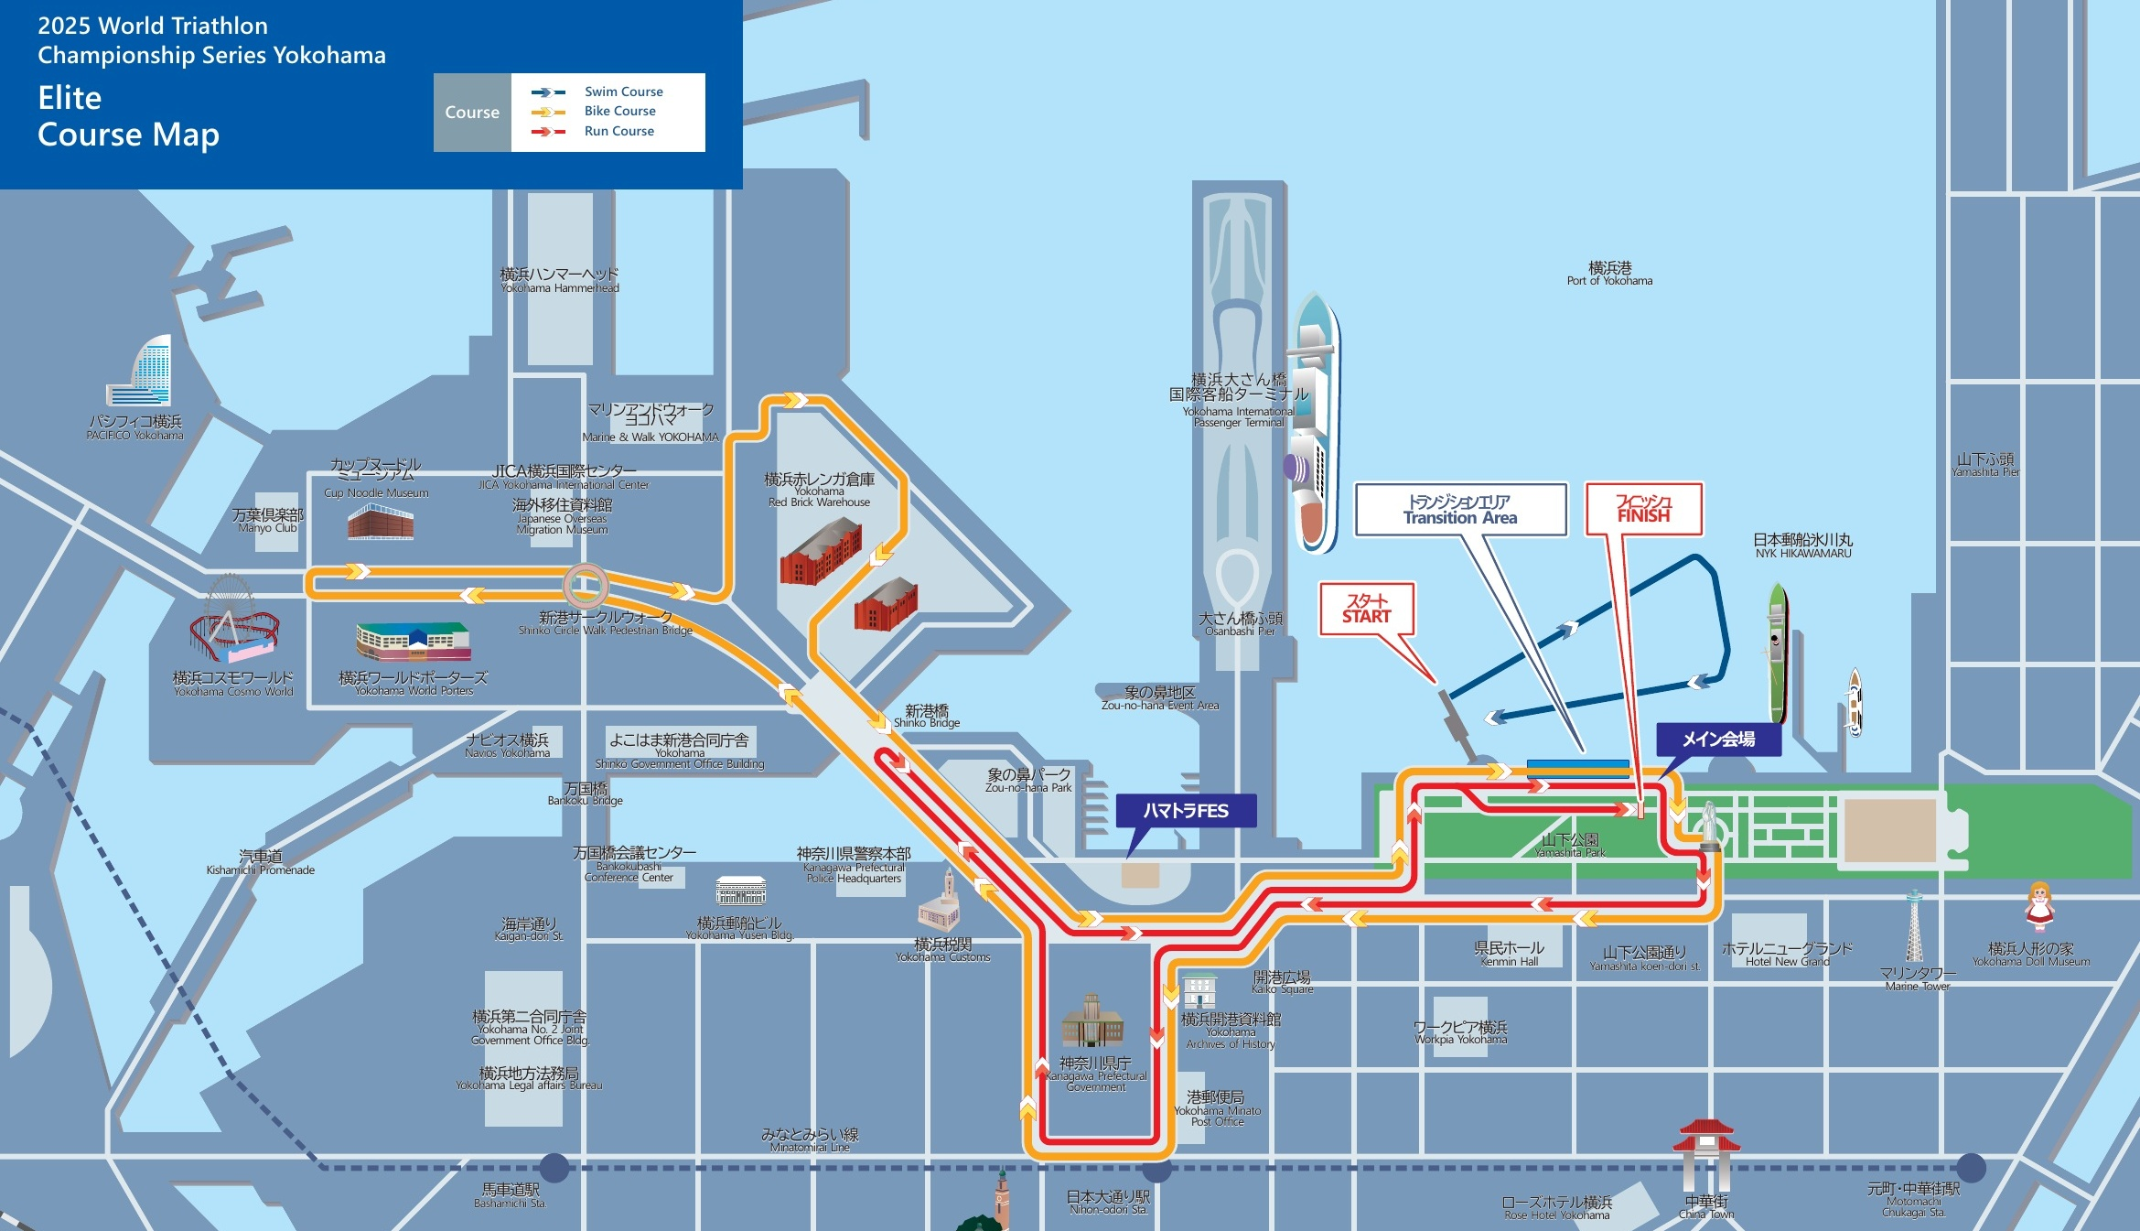
Course Profile & Map
Yokohama
2026 Course
2025 Course
Source: 2026 World Triathlon race info / course map
Source: 2025 Yokohama course map PDF
Discipline | Distance | Laps | Terrain / Notes
Swim | 1.5 km | 2 | Sea swim from pontoon on Yokohama waterfront
Bike | 40.0 km (2026) 37.2 km (2025) | 10 | Flat urban multi-lap course; 2025 result shortened by conditions
Run | 10.0 km | 4 | Flat multi-lap run; Surface likely pavement/concrete

Slide 4
Environmental Risk Profile
Yokohama
RACE-DAY WEATHER (08:00–11:00 local)
AIR QUALITY (Open-Meteo archive)
Year | Date | Air Temp | Humidity | Wind km/h | Precip mm
2018 | May 12 | 20.1 | 64% | 9 | 0.0
2019 | May 18 | 19.7 | 62% | 21 | 0.0
2021 | May 15 | 22.1 | 70% | 6 | 0.0
2022 | May 14 | 22.0 | 93% | 15 | 8.8
2023 | May 13 | 17.1 | 78% | 12 | 0.4
2024 | May 11 | 20.9 | 56% | 28 | 0.0
2025 | May 17 | 21.6 | 93% | 23 | 1.5
Year | PM2.5 | EU AQI | UV Index | Risk
2018 | — | — | — | —
2019 | — | — | — | —
2021 | — | — | — | —
2022 | — | — | — | —
2023 | 21.1 | 37 | 3.1 | Fair
2024 | 15.8 | 43 | 5.8 | Moderate
2025 | 12.7 | 35 | 1.6 | Fair
HEALTH & WATER QUALITY RISK FACTORS
• Water Quality: No public Yokohama race-week illness cluster or swim cancellation found.
• Athlete Health / GI Risk: No known history at Yokohama
• Water Temperature: Historically cool/borderline in May: ~17.5–20.2°C. 2024 women: 19.8°C wetsuit allowed; 2025: ~20.1–20.2°C and wetsuit forbidden.
• Heat / Humidity: Air temp is usually moderate (17–22°C), but humidity can spike >90% in wet years. 2024 women had the warmest listed start conditions at 25.4°C.
Weather/AQ data: Open-Meteo historical archive; water-quality context: Yokohama City sea-area monitoring/restoration pages + World Triathlon water-quality standards. Water-temp values: PPT/WT API where available; * values are estimates.

Slide 5
Travel & Arrival Load
Denver, CO → Yokohama race week
Core travel read
Denver to Tokyo (NRT) offers a direct 12h flight helping make this long-haul travel more manageable. With a significant 15-hour time zone shift plan arrival multiple days in advance to help get on a proper schedule b
The main performance cost is the 15-hour time-zone shift plus long-haul flight load. If possible, plan arrival 5–7 days before race day so athletes can absorb sleep timing, GI rhythm, and shakeout logistics before course familiarization.
Primary route
DEN → NRT
Nonstop option available
Flight time
~12h 10m
direct average
Time zones
+15h
Tokyo ahead of Denver
HND transfer
22 km
~24–40 min bus
NRT transfer
96 km
~1h50–2h45
Host Hotel / Official Accommodation Read
• Official 2026 accommodation link lists four hotels: Rose Hotel Yokohama, Hotel New Grand, THE GATE HOTEL YOKOHAMA by HULIC, and Citadines Harbour Front Yokohama.
• Best race-logistics read: THE GATE / Hotel New Grand are closest to Yamashita Park; Rose is Chinatown side and walkable; Citadines is by Nihon-odori with kitchenette / laundry-style athlete value.
• Quality read: THE GATE is newest (opened 2025) and reviewed as clean/modern; New Grand is premium/historic; Rose is convenient but more dated; Citadines is strongest for longer stays/self-catering.
• Price: public snapshots vary by date; recent OTA examples show THE GATE from ~$120/night and Rose from ~¥22,000 for 2 guests with breakfast.
Food / Grocery Options Near Hotel + Venue
• Best grocery targets: Motomachi Union and Bio c’ Bon in Motomachi for premium/imported/organic staples; Maruetsu Petit Yamashita Koen and My Basket Yamashitacho for quick basics near the park.
• Budget/larger stock-up: OK ShinYamashita is ~900m from Motomachi-Chukagai and works better for volume groceries, drinks, snacks, and simple room food.
• Convenience backup: FamilyMart / 7-Eleven / Natural Lawson around Motomachi-Chukagai and Ishikawacho for water, rice balls, yogurt, coffee, and emergency snacks.
• Food read: Safe. No major food concern risks for travelers.
Sources: World Triathlon 2026 travel/accommodation link + JTB official hotel list; Yokohama Visitors Guide; Expedia/Hotels.com/Tripadvisor review summaries; Tabelog/Navitime/Motomachi Shopping Street grocery listings.

Slide 6
ELITE MEN

Slide 7
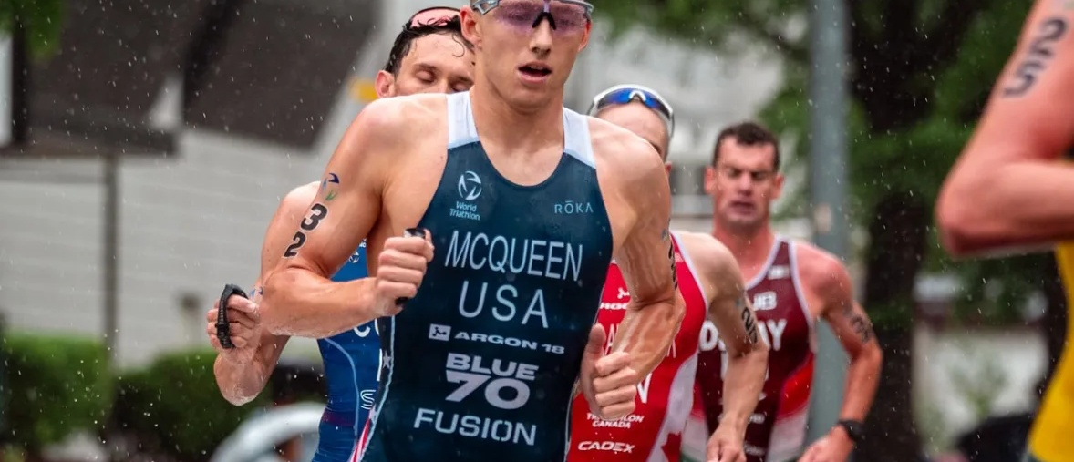
Race Overview — Elite Men
Yokohama
RACE HISTORY AT YOKOHAMA
3 KEYS TO SUCCESS
Yokohama has been a consistently fast Olympic-distance race on the circuit. Swim separation is usually limited, with most years putting 20–35 athletes within 15 seconds of the swim leader. 2019 and 2025 were the exceptions, with smaller groups making the bike more selective. The race is usually decided late, with a low-29-minute 10 km often required to win.
1
Good but not great swimming. Do what is needed to be in the front pack, but do not expect the swim alone to create a small race-winning group.
2
Expect rain and wet roads. Bike handling, cornering, and staying near the front of the group are critical.
3
Plan for a large group into T2. A ~29-minute 10K is likely needed to fight for the podium.

Slide 8
Results Summary — Elite Men
Yokohama
Year | Date | Category | Field | Winner | Winner Time
2018 | May 12 | World Championship Series | 48 | Mola | 1:44:59
2019 | May 18 | World Championship Series | 45 | Luis | 1:43:21
2021 | May 15 | World Championship Series | 48 | Blummenfelt | 1:42:55
2022 | May 14 | World Championship Series * | 45 | Yee | 1:43:30
2023 | May 13 | World Championship Series * | 49 | Wilde | 1:42:13
2024 | May 11 | World Championship Series | 47 | Pearson | 1:42:05
2025 | May 17 | World Championship Series * | 42 | Hauser | 1:41:08
* Course distance changed vs. prior year

Slide 9
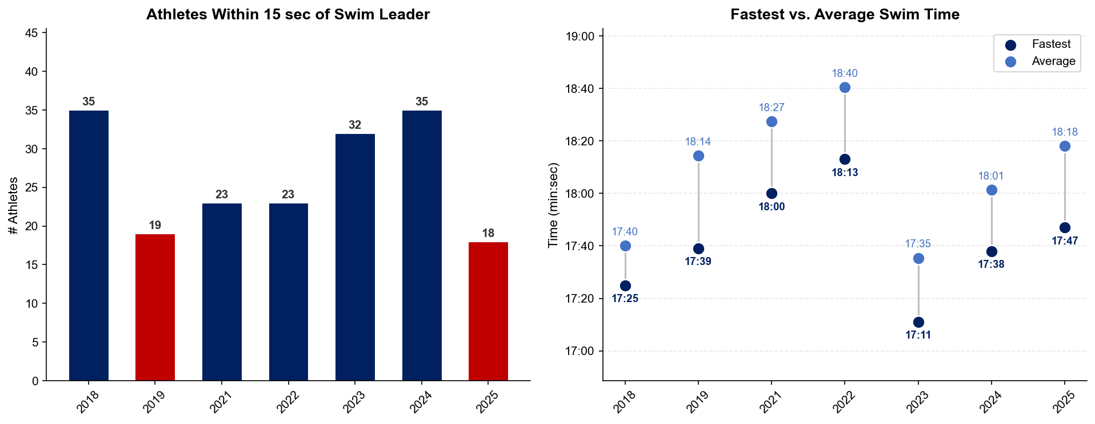
Swim Exit Dynamics — Elite Men
Yokohama

Slide 10
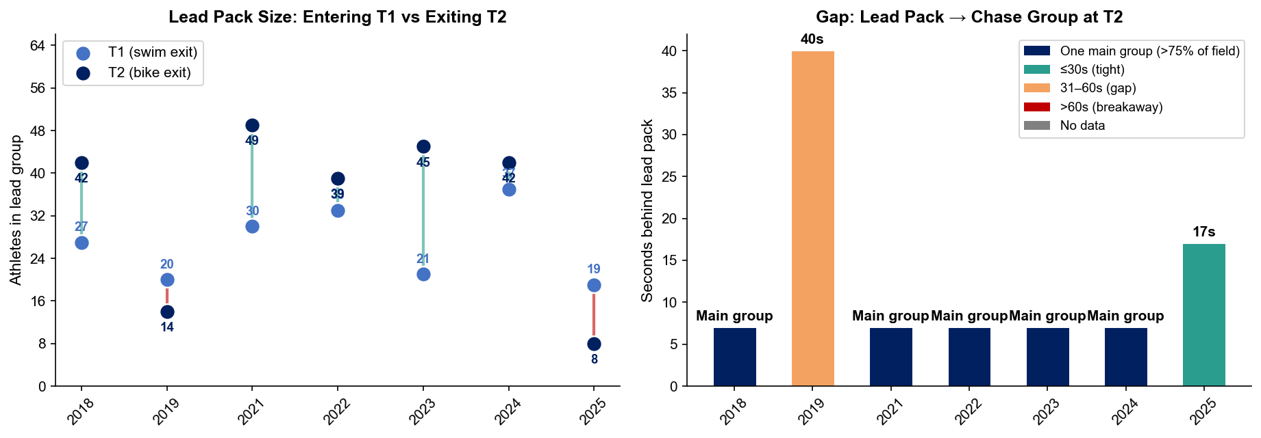
Bike Pack Evolution — Elite Men
Yokohama
Lead pack = athletes within 15 sec of leader. T1 = lead group entering the bike; T2 = lead group exiting the bike.
Year | Lead Size @ T1 | Lead Size @ T2 | Change | Chase Group @ T2 | Chase Gap*
2018 | 27 | 42 | +15 | 8 | 44s
2019 | 20 | 14 | -6 | 25 | 40s
2021 | 30 | 49 | +19 | 1 | 205s
2022 | 33 | 39 | +6 | 9 | 38s
2023 | 21 | 45 | +24 | 1 | 35s
2024 | 37 | 42 | +5 | 6 | 8s
2025 | 19 | 8 | -11 | 22 | 17s
Lead pack = athletes within 15 sec of leader. Chase group = athletes within 15 sec of the first athlete outside the lead pack. * Chase Gap = seconds from the last lead-pack athlete to the first chase-group athlete at T2.

Slide 11
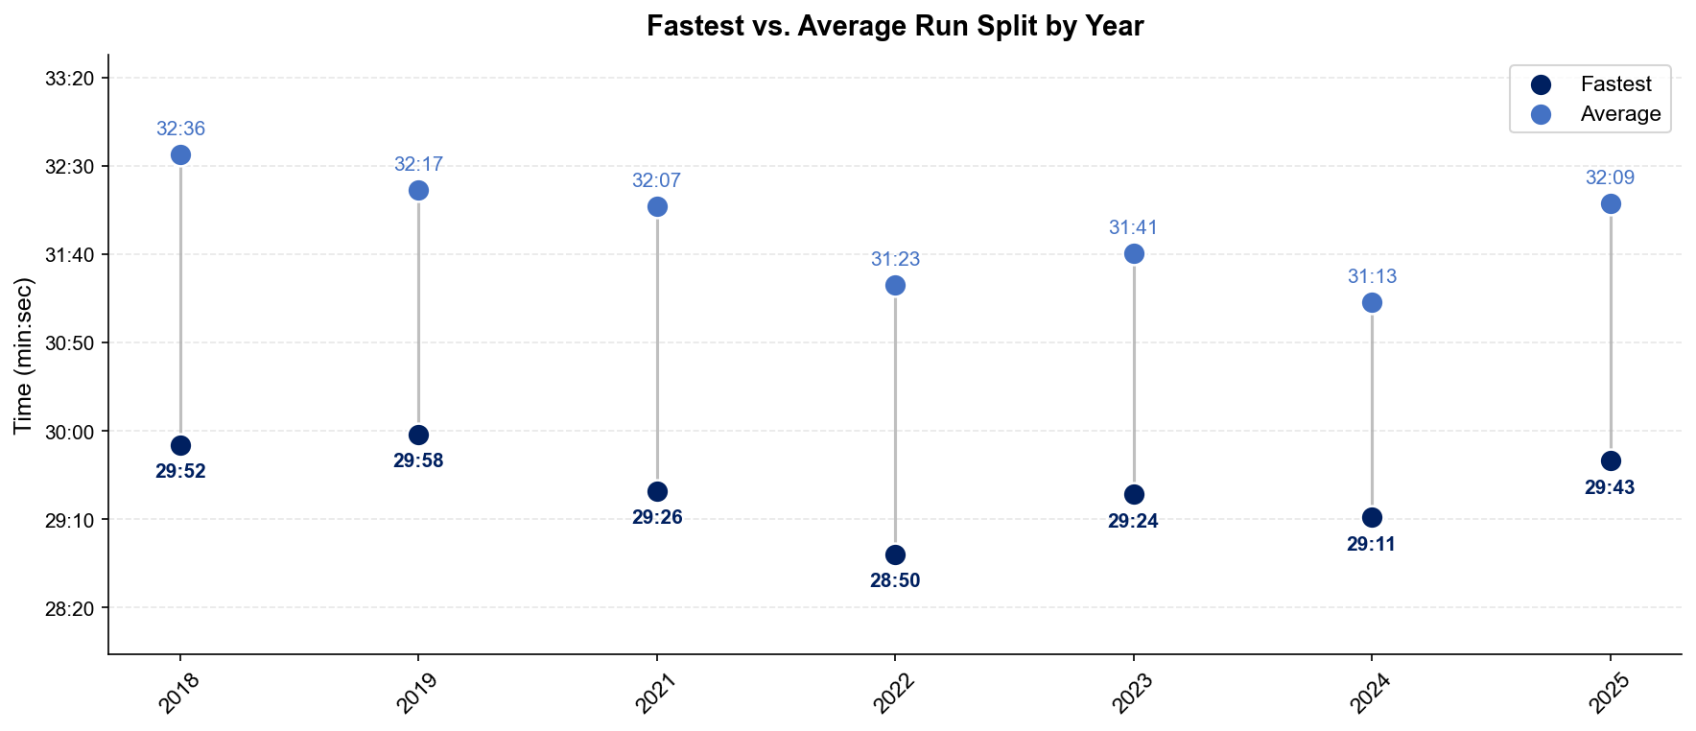
Run Split Analysis — Elite Men
Yokohama

Slide 12
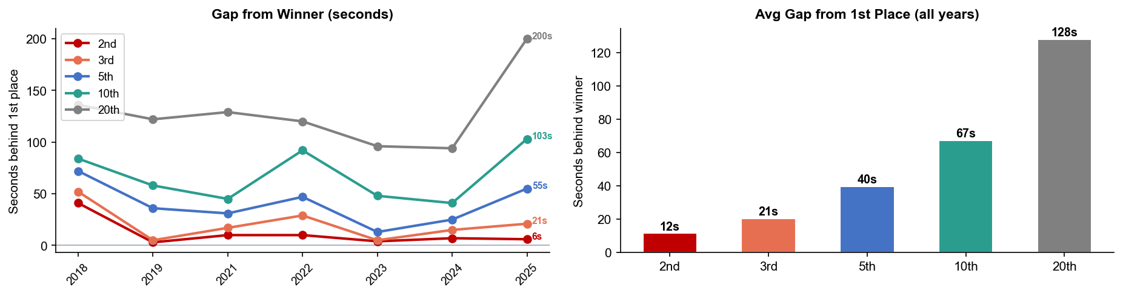
Key Position Times — Elite Men
Yokohama
Year | 1st | 2nd | 3rd | 5th | 10th | 20th
2018 | 1:44:59 | 1:45:40 +41s | 1:45:51 +52s | 1:46:11 +72s | 1:46:23 +84s | 1:47:15 +136s
2019 | 1:43:21 | 1:43:24 +3s | 1:43:26 +5s | 1:43:57 +36s | 1:44:19 +58s | 1:45:23 +122s
2021 | 1:42:55 | 1:43:05 +10s | 1:43:12 +17s | 1:43:26 +31s | 1:43:40 +45s | 1:45:04 +129s
2022 | 1:43:30 | 1:43:40 +10s | 1:43:59 +29s | 1:44:17 +47s | 1:45:02 +92s | 1:45:30 +120s
2023 | 1:42:13 | 1:42:17 +4s | 1:42:18 +5s | 1:42:26 +13s | 1:43:01 +48s | 1:43:49 +96s
2024 | 1:42:05 | 1:42:12 +7s | 1:42:20 +15s | 1:42:30 +25s | 1:42:46 +41s | 1:43:39 +94s
2025 | 1:41:08 | 1:41:14 +6s | 1:41:29 +21s | 1:42:03 +55s | 1:42:51 +103s | 1:44:28 +200s

Slide 13
Race Conditions — Elite Men
Yokohama
Year | Date | Air Temp | Humidity | Wind (km/h) | Precip (mm) | Water Temp | Wetsuit | Conditions
2018 | May 12 | 20.1 | 64% | 9 | 0.0 | — | — | —
2019 | May 18 | 19.7 | 62% | 21 | 0.0 | — | — | —
2021 | May 15 | 22.1 | 70% | 6 | 0.0 | — | — | —
2022 | May 14 | 22.0 | 93% | 15 | 8.8 | — | — | —
2023 | May 13 | 17.1 | 78% | 12 | 0.4 | 17.5°* | — | —
2024 | May 11 | 20.9 | 56% | 28 | 0.0 | 18.4°* | — | —
2025 | May 17 | 21.6 | 93% | 23 | 1.5 | 20.1 | — | —
Air temp, humidity, wind, and precipitation sourced from Open-Meteo historical archive (race window 08:00–11:00 local) where WT API data is absent. Values marked * are Open-Meteo estimates. Water temp and wetsuit ruling are from the World Triathlon API per program.

Slide 14
ELITE WOMEN

Slide 15
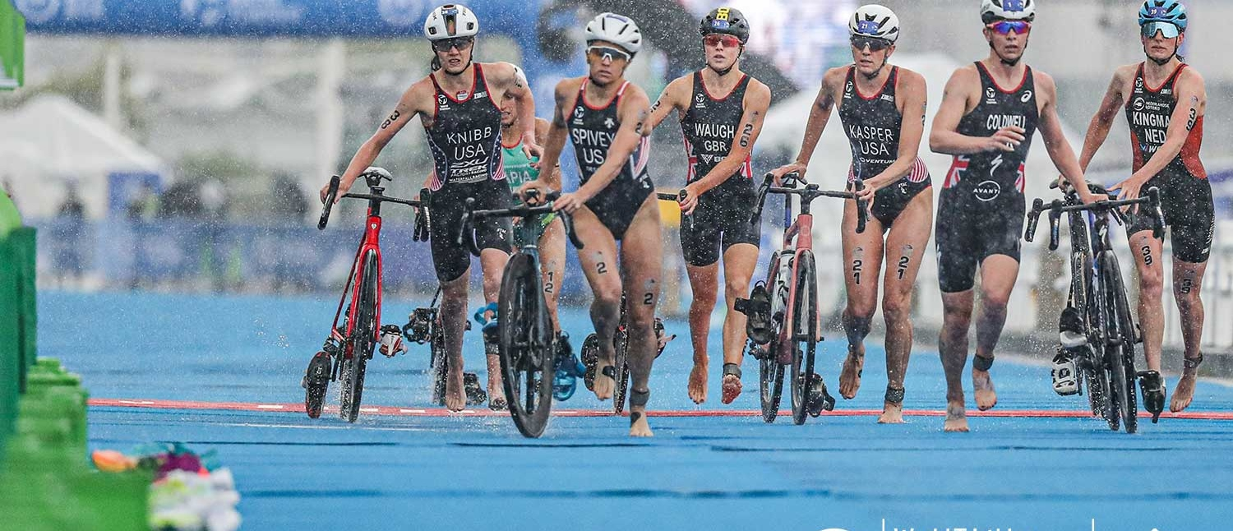
Race Overview — Elite Women
Yokohama
RACE HISTORY AT YOKOHAMA
3 KEYS TO SUCCESS
The women’s race at Yokohama has usually been more selective than the men’s race. The swim matters more because the first athletes out of the water often form the key breakaway. The 2025 race was different, with heavy rain and a shortened bike bringing a larger group into T2, but the winner was still present at the front all day. Winning times usually sit from 1:51–1:54.
1
Swim near the front to give yourself the best chance of making the likely break.
2
Be ready for poor weather and high-stress bike positioning. Missing the front group can turn the rest of the day into a chase.
3
To win, expect to need a sub-33:30 10K unless the front group builds a major bike advantage.

Slide 16
Results Summary — Elite Women
Yokohama
Year | Date | Category | Field | Winner | Winner Time
2018 | May 12 | World Championship Series | 46 | Duffy | 1:53:26
2019 | May 18 | World Championship Series | 39 | Zaferes | 1:52:12
2021 | May 15 | World Championship Series | 49 | Knibb | 1:54:27
2022 | May 14 | World Championship Series * | 33 | Taylor-Brown | 1:51:44
2023 | May 13 | World Championship Series * | 52 | Coldwell | 1:53:32
2024 | May 11 | World Championship Series | 55 | Periault | 1:52:28
2025 | May 17 | World Championship Series * | 40 | Lehair | 1:51:34
* Course distance changed vs. prior year

Slide 17
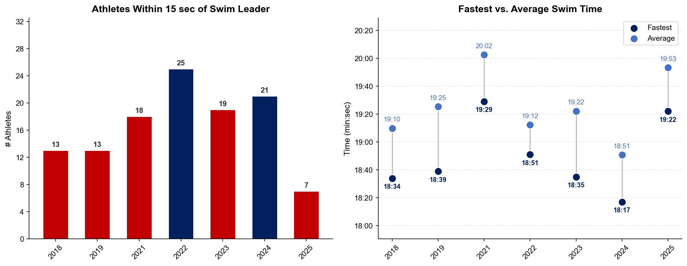
Swim Exit Dynamics — Elite Women
Yokohama

Slide 18
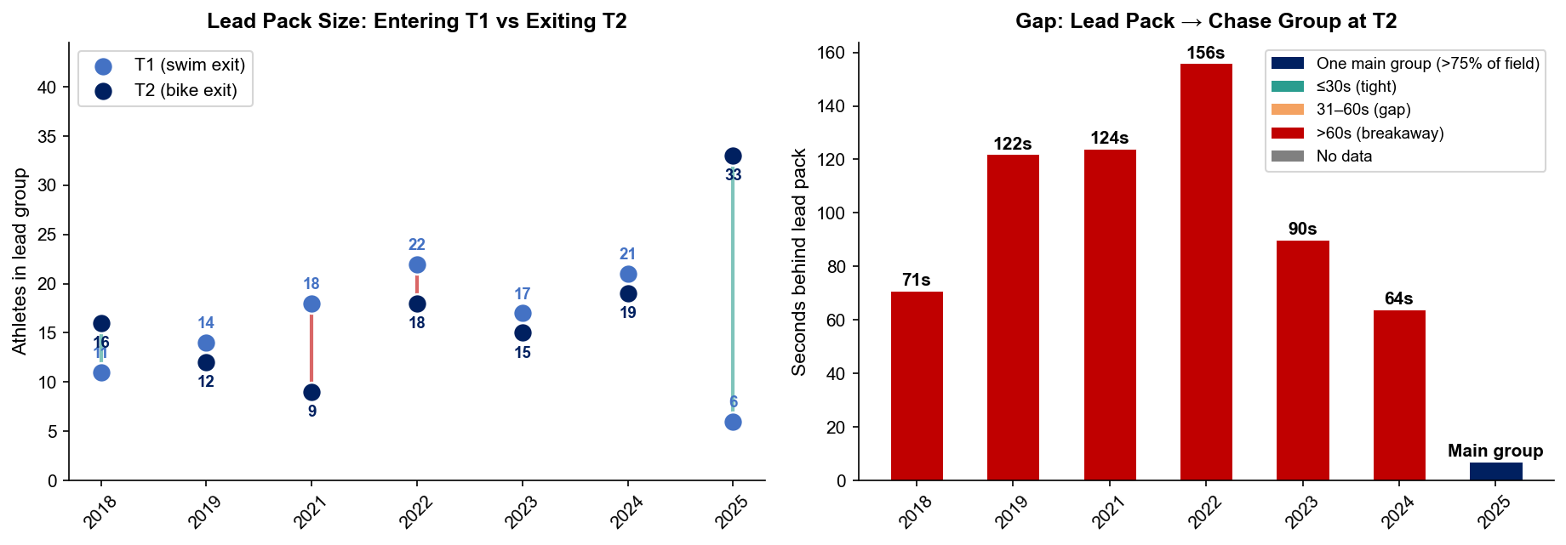
Bike Pack Evolution — Elite Women
Yokohama
Lead pack = athletes within 15 sec of leader. T1 = lead group entering the bike; T2 = lead group exiting the bike.
Year | Lead Size @ T1 | Lead Size @ T2 | Change | Chase Group @ T2 | Chase Gap*
2018 | 11 | 16 | +5 | 20 | 71s
2019 | 14 | 12 | -2 | 6 | 122s
2021 | 18 | 9 | -9 | 26 | 124s
2022 | 22 | 18 | -4 | 14 | 156s
2023 | 17 | 15 | -2 | 12 | 90s
2024 | 21 | 19 | -2 | 5 | 64s
2025 | 6 | 33 | +27 | 4 | 158s
Lead pack = athletes within 15 sec of leader. Chase group = athletes within 15 sec of the first athlete outside the lead pack. * Chase Gap = seconds from the last lead-pack athlete to the first chase-group athlete at T2.

Slide 19
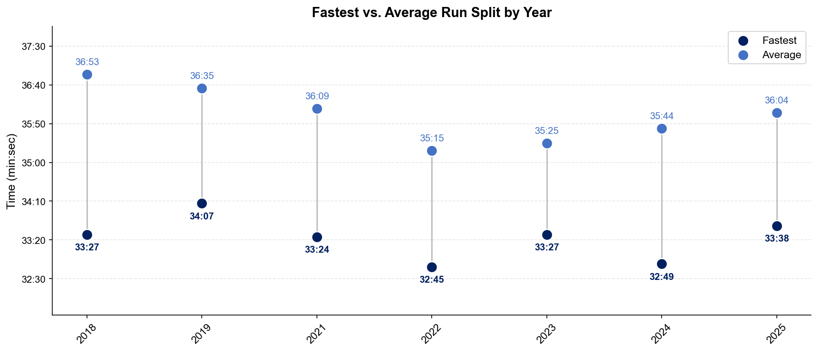
Run Split Analysis — Elite Women
Yokohama

Slide 20
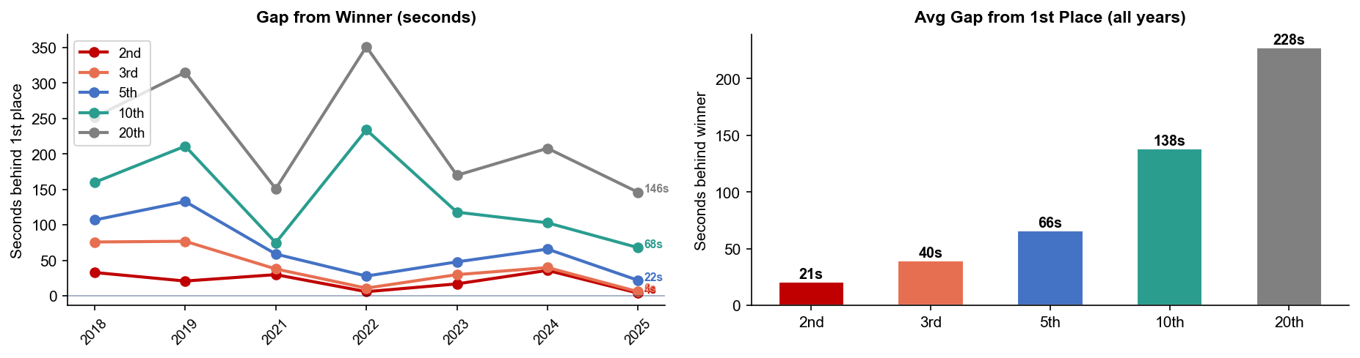
Key Position Times — Elite Women
Yokohama
Year | 1st | 2nd | 3rd | 5th | 10th | 20th
2018 | 1:53:26 | 1:53:59 +33s | 1:54:42 +76s | 1:55:13 +107s | 1:56:06 +160s | 1:57:38 +252s
2019 | 1:52:12 | 1:52:33 +21s | 1:53:29 +77s | 1:54:25 +133s | 1:55:43 +211s | 1:57:27 +315s
2021 | 1:54:27 | 1:54:57 +30s | 1:55:05 +38s | 1:55:26 +59s | 1:55:42 +75s | 1:56:58 +151s
2022 | 1:51:44 | 1:51:50 +6s | 1:51:55 +11s | 1:52:12 +28s | 1:55:38 +234s | 1:57:35 +351s
2023 | 1:53:32 | 1:53:49 +17s | 1:54:02 +30s | 1:54:20 +48s | 1:55:30 +118s | 1:56:22 +170s
2024 | 1:52:28 | 1:53:04 +36s | 1:53:08 +40s | 1:53:34 +66s | 1:54:11 +103s | 1:55:56 +208s
2025 | 1:51:34 | 1:51:38 +4s | 1:51:40 +6s | 1:51:56 +22s | 1:52:42 +68s | 1:54:00 +146s

Slide 21
Race Conditions — Elite Women
Yokohama
Year | Date | Air Temp | Humidity | Wind (km/h) | Precip (mm) | Water Temp | Wetsuit | Conditions
2018 | May 12 | 20.1 | 64% | 9 | 0.0 | — | — | —
2019 | May 18 | 19.7 | 62% | 21 | 0.0 | — | — | —
2021 | May 15 | 22.1 | 70% | 6 | 0.0 | — | — | —
2022 | May 14 | 22.0 | 93% | 15 | 8.8 | — | — | —
2023 | May 13 | 17.1 | 78% | 12 | 0.4 | 17.5°* | — | —
2024 | May 11 | 25.4 | 56% | 28 | 0.0 | 19.8 | allowed | —
2025 | May 17 | 19.8 | 93% | 23 | 1.5 | 20.2 | forbidden | —
Air temp, humidity, wind, and precipitation sourced from Open-Meteo historical archive (race window 08:00–11:00 local) where WT API data is absent. Values marked * are Open-Meteo estimates. Water temp and wetsuit ruling are from the World Triathlon API per program.

